Slide 1
Triangle xy area
Problem Solvers Handbook
Ex 3.5 Q7

Slide 2
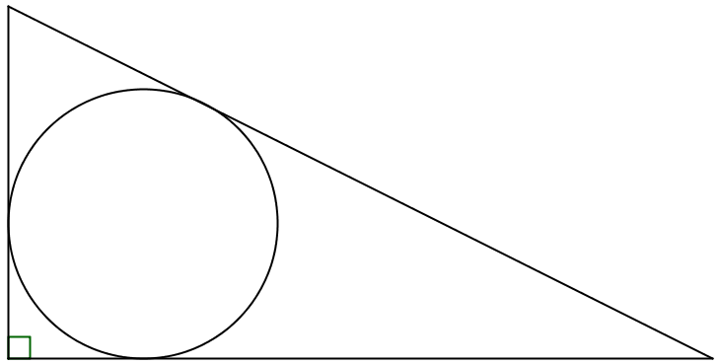
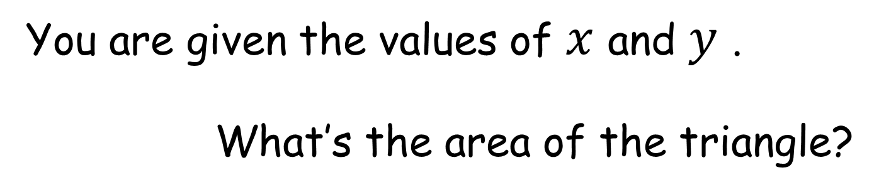


You are given the values of $x$ and $y$ .
What’s the area of the triangle?
$$x$$
(not to scale)
$$y$$
(The circle is tangent to the three sides of the triangle.)
Notes:
Area = $xy$

Slide 3
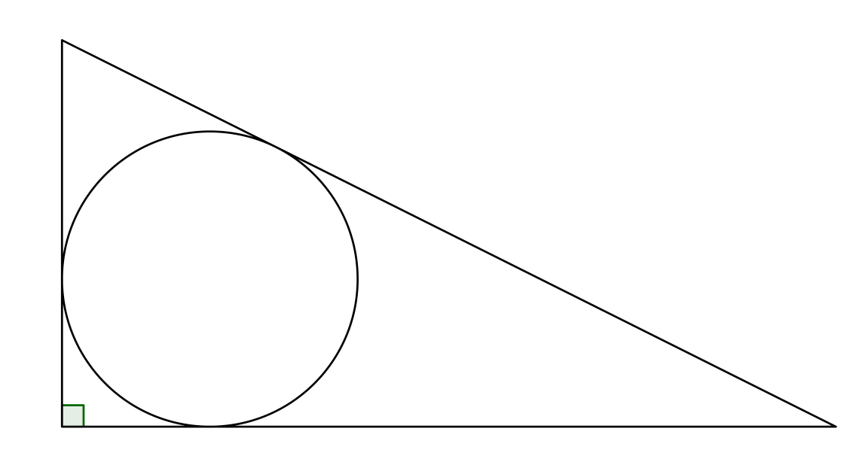




$$x$$
$$x$$
$$y$$
$$y$$
Notes:
Area = $xy$

Slide 4
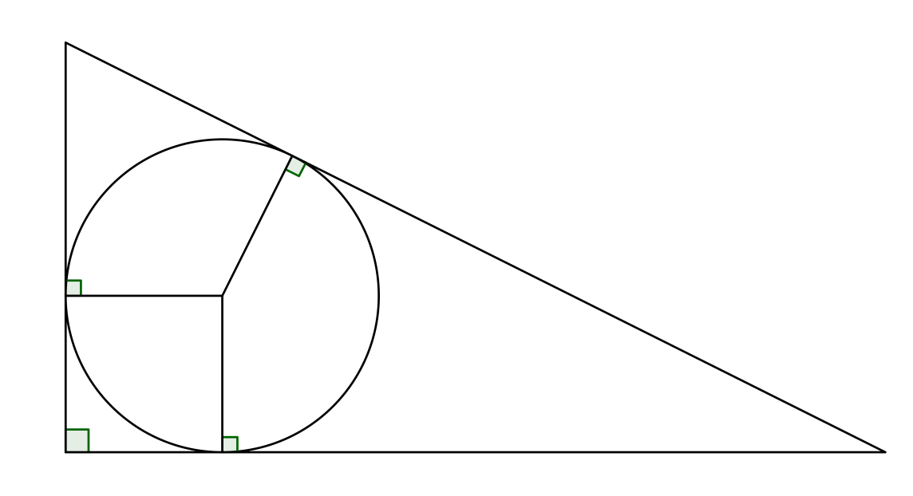


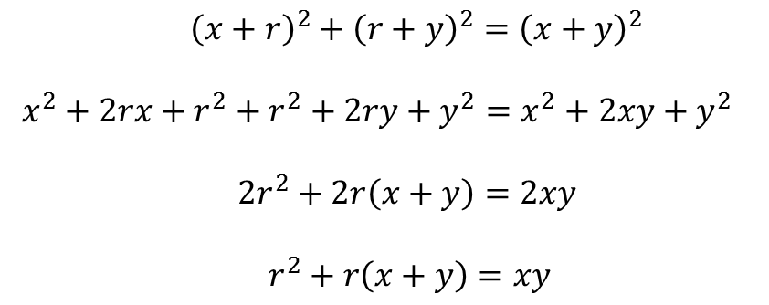

$$x$$
$$x$$
$$r$$
$$y$$
$$r$$
$$r$$
$$y$$
${\left(x+r\right)}^{2}+{\left(r+y\right)}^{2}={\left(x+y\right)}^{2}$
$x^{2}+2rx+r^{2}+r^{2}+2ry+y^{2}=x^{2}+2xy+y^{2}$
$2r^{2}+2r\left(x+y\right)=2xy$
$r^{2}+r\left(x+y\right)=xy$
(Pythagoras)

Slide 5
$$x$$
$$x$$
$$r$$
$$y$$
$$r$$
$$r$$
$$y$$

Slide 6
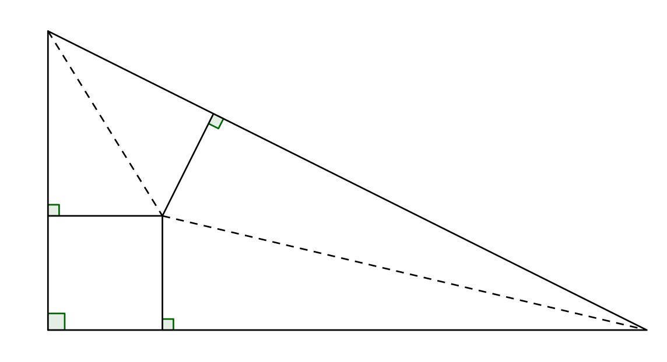
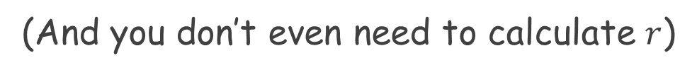
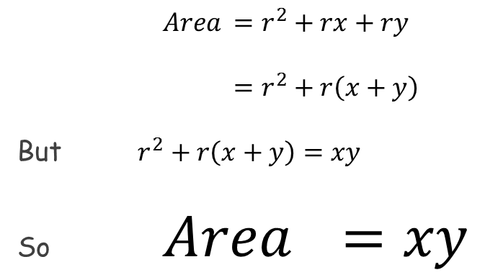
$$x$$
$$x$$
$$r$$
$$y$$
$$r$$
$$r$$
$$y$$
$Area$ $=r^{2}+rx+ry$
$=r^{2}+r\left(x+y\right)$
But $r^{2}+r\left(x+y\right)=xy$
So $Area$ $=xy$
(square and two kites)
(found previously)
(And you don’t even need to calculate $r$)

Slide 7
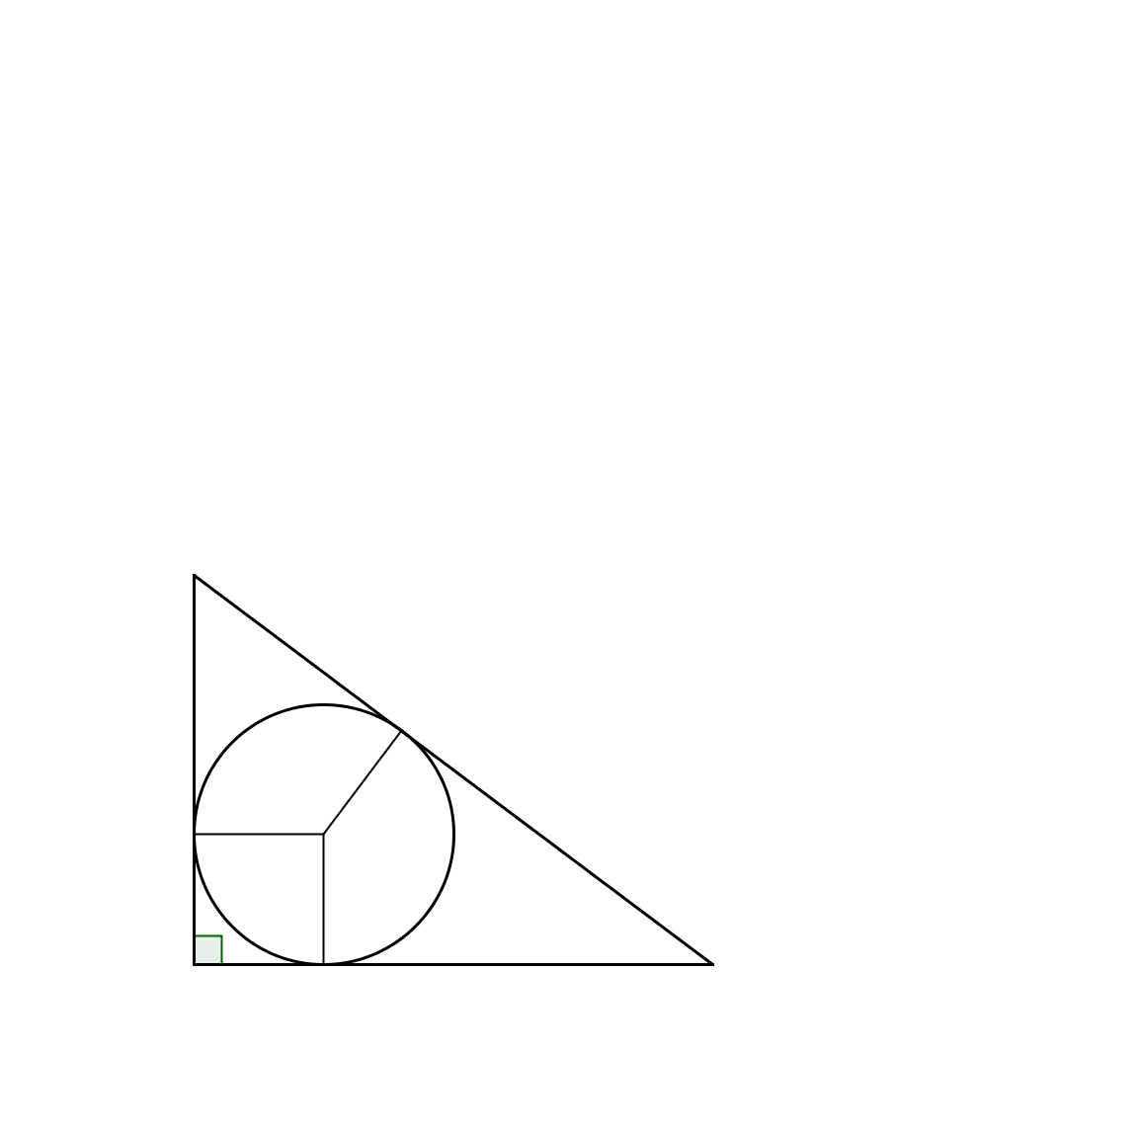



Supplementary:
What is the radius of the circle touching the three sides of the triangle?
$$3$$
$$r$$
$$4$$

Slide 8





Supplementary:
What is the radius of the circle touching the three sides of the triangle?
$$\frac{1}{2}\left(3\right)\left(4\right)=r^{2}+r\left(3−r\right)+r\left(4−r\right)$$
$$6=r^{2}+3r−r^{2}+4r−r^{2}$$
$$6=7r−r^{2}$$
$$r^{2}−7r+6=0$$
$$\left(r−1\right)\left(r−6\right)=0$$
So $r=1$ or $r=6$
$$3−r$$
$$3$$
$$r$$
$$r$$
$$4$$
$$r$$
$$4−r$$

Slide 9





Supplementary:
What is the radius of the circle touching the three sides of the triangle?
$$\frac{1}{2}\left(3\right)\left(4\right)=r^{2}+r\left(3−r\right)+r\left(4−r\right)$$
$$6=r^{2}+3r−r^{2}+4r−r^{2}$$
$$6=7r−r^{2}$$
$$r^{2}−7r+6=0$$
$$\left(r−1\right)\left(r−6\right)=0$$
So $r=1$ or $r=6$
$$3−r$$
$$2$$
$$r$$
$$1$$
$$1$$
$$r$$
$$1$$
$$4−r$$
$$r$$
$$3$$
But what about the other answer?

Slide 10
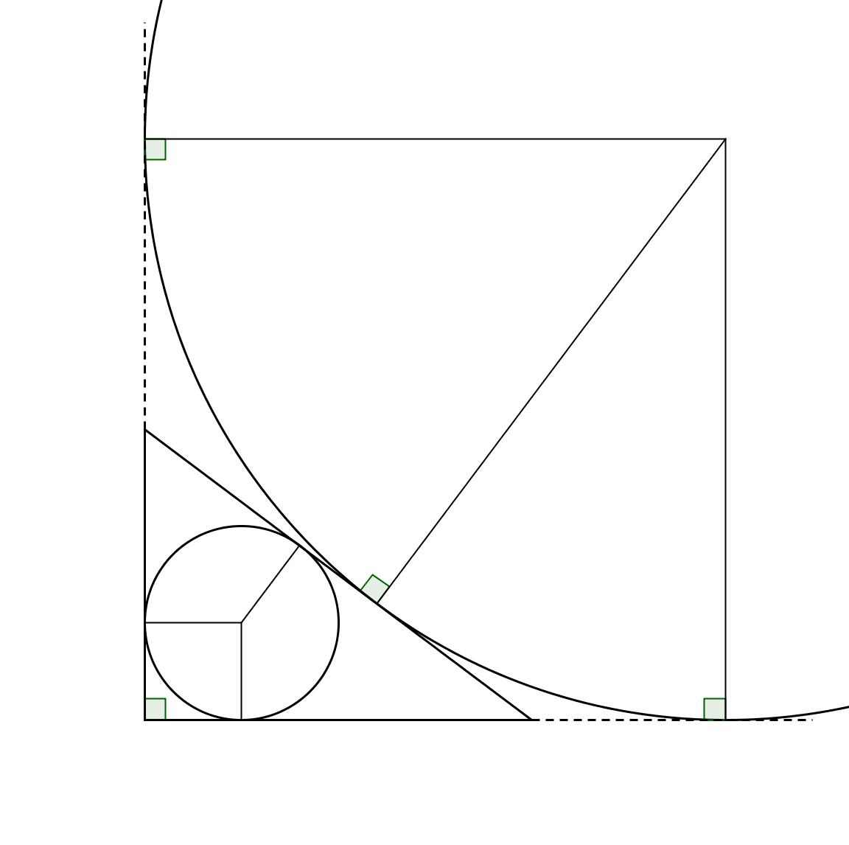



$$6$$
$$6$$
$$6$$
$$1$$
But why did algebra bring up this answer?

Slide 11
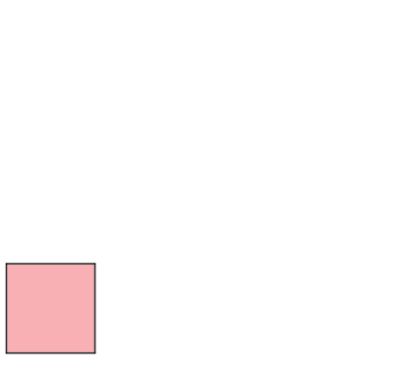
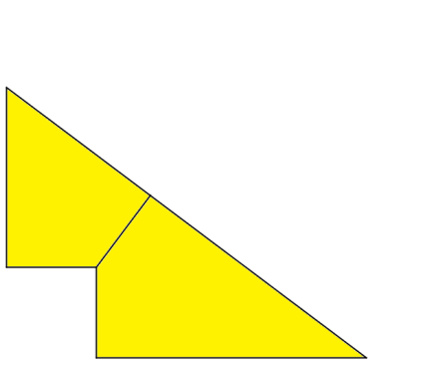
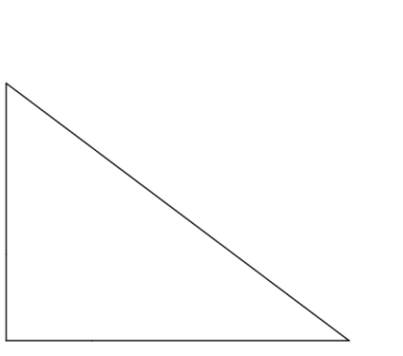
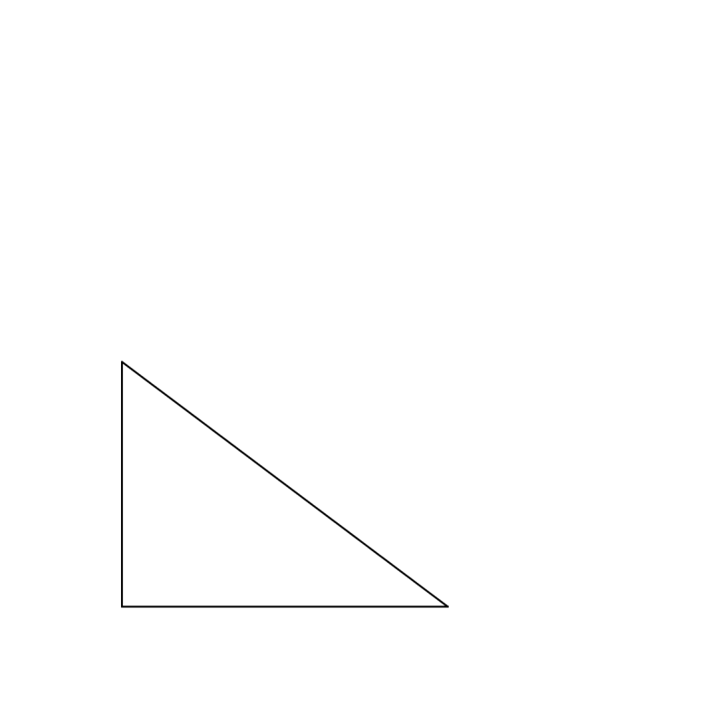
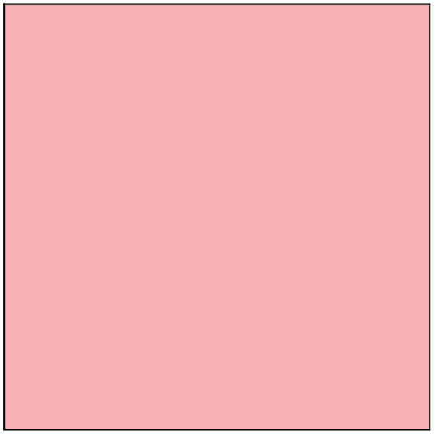
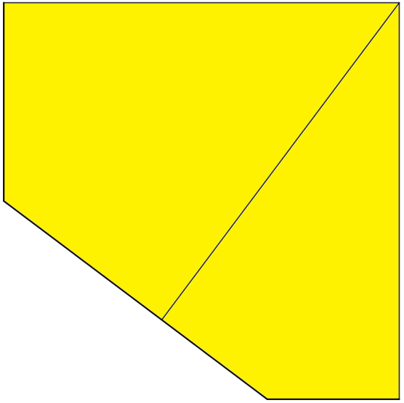






$$r=1$$
$$3$$
$$4$$
$$r=6$$
$$3$$
$$4$$

Slide 13
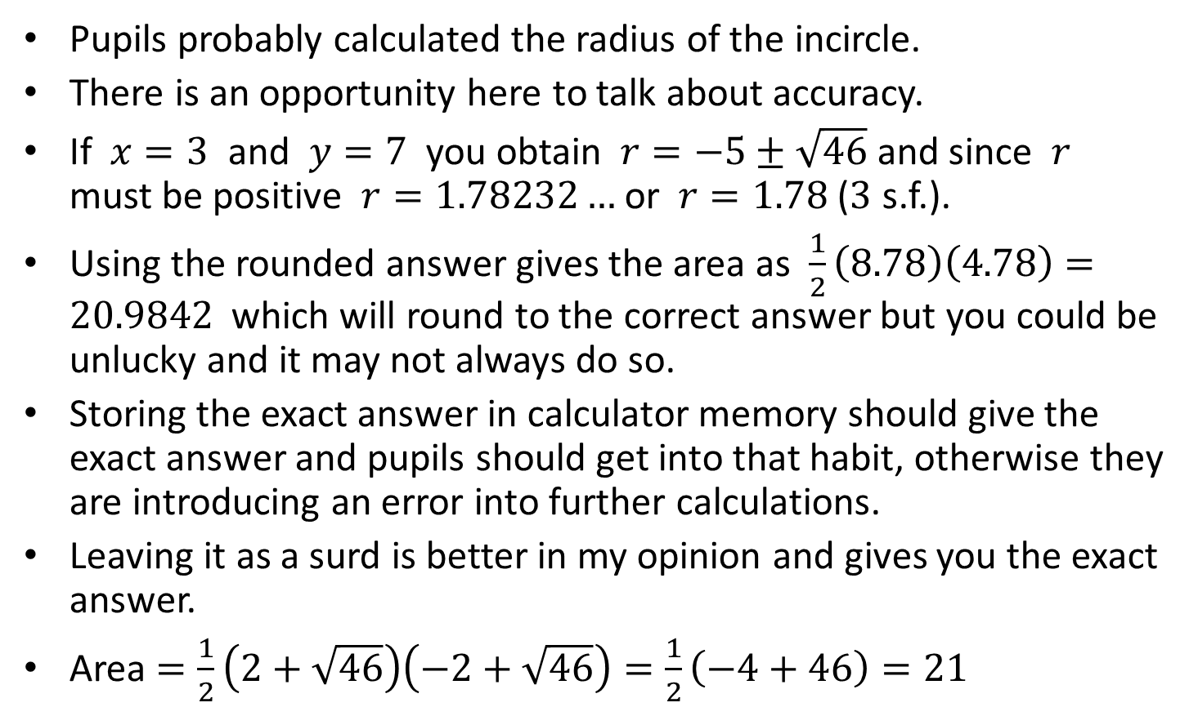
Note to Teacher - 1
Pupils probably calculated the radius of the incircle.
There is an opportunity here to talk about accuracy.
If $x=3$ and $y=7$ you obtain $r=−5±\sqrt{46}$ and since $r$ must be positive $r=1.78232…$ or $r=1.78$ ($3$ s.f.).
Using the rounded answer gives the area as $\frac{1}{2}\left(8.78\right)\left(4.78\right)=20.9842$ which will round to the correct answer but you could be unlucky and it may not always do so.
Storing the exact answer in calculator memory should give the exact answer and pupils should get into that habit, otherwise they are introducing an error into further calculations.
Leaving it as a surd is better in my opinion and gives you the exact answer.
Area $=\frac{1}{2}\left(2+\sqrt{46}\right)\left(−2+\sqrt{46}\right)=\frac{1}{2}\left(−4+46\right)=21$

Slide 14
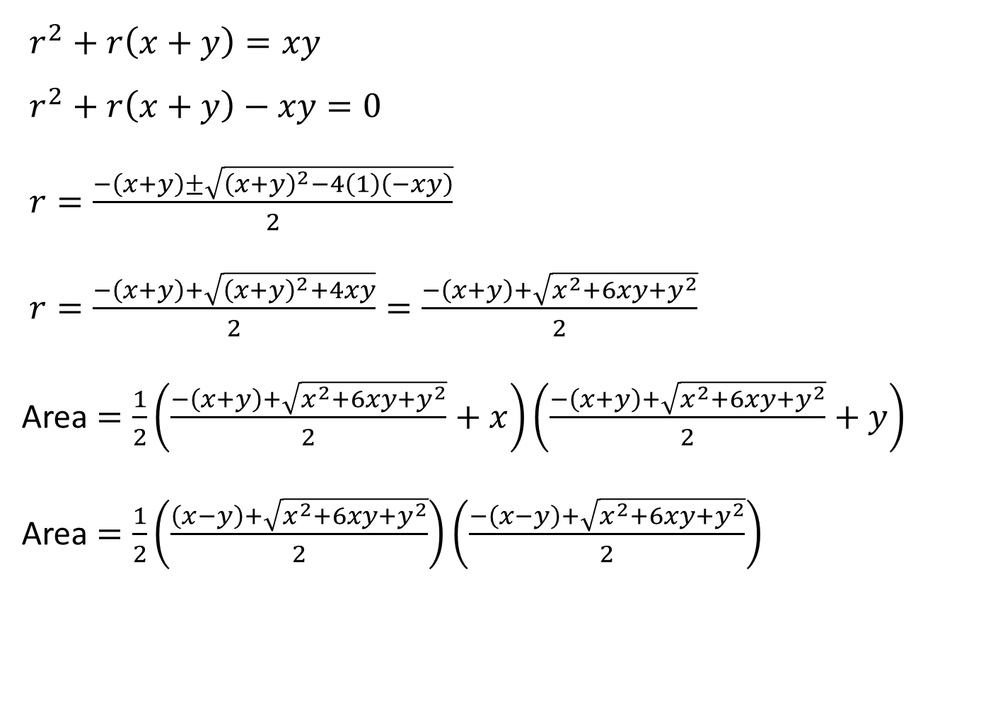
The general case without using two kites and a square.
$r^{2}+r\left(x+y\right)=xy$
$r^{2}+r\left(x+y\right)−xy=0$
$r=\frac{−\left(x+y\right)±\sqrt{{\left(x+y\right)}^{2}−4\left(1\right)\left(−xy\right)}}{2}$
$r=\frac{−\left(x+y\right)+\sqrt{{\left(x+y\right)}^{2}+4xy}}{2}=\frac{−\left(x+y\right)+\sqrt{x^{2}+6xy+y^{2}}}{2}$
Area $=\frac{1}{2}\left(\frac{−\left(x+y\right)+\sqrt{x^{2}+6xy+y^{2}}}{2}+x\right)\left(\frac{−\left(x+y\right)+\sqrt{x^{2}+6xy+y^{2}}}{2}+y\right)$
Area $=\frac{1}{2}\left(\frac{\left(x−y\right)+\sqrt{x^{2}+6xy+y^{2}}}{2}\right)\left(\frac{−\left(x−y\right)+\sqrt{x^{2}+6xy+y^{2}}}{2}\right)$

Slide 15
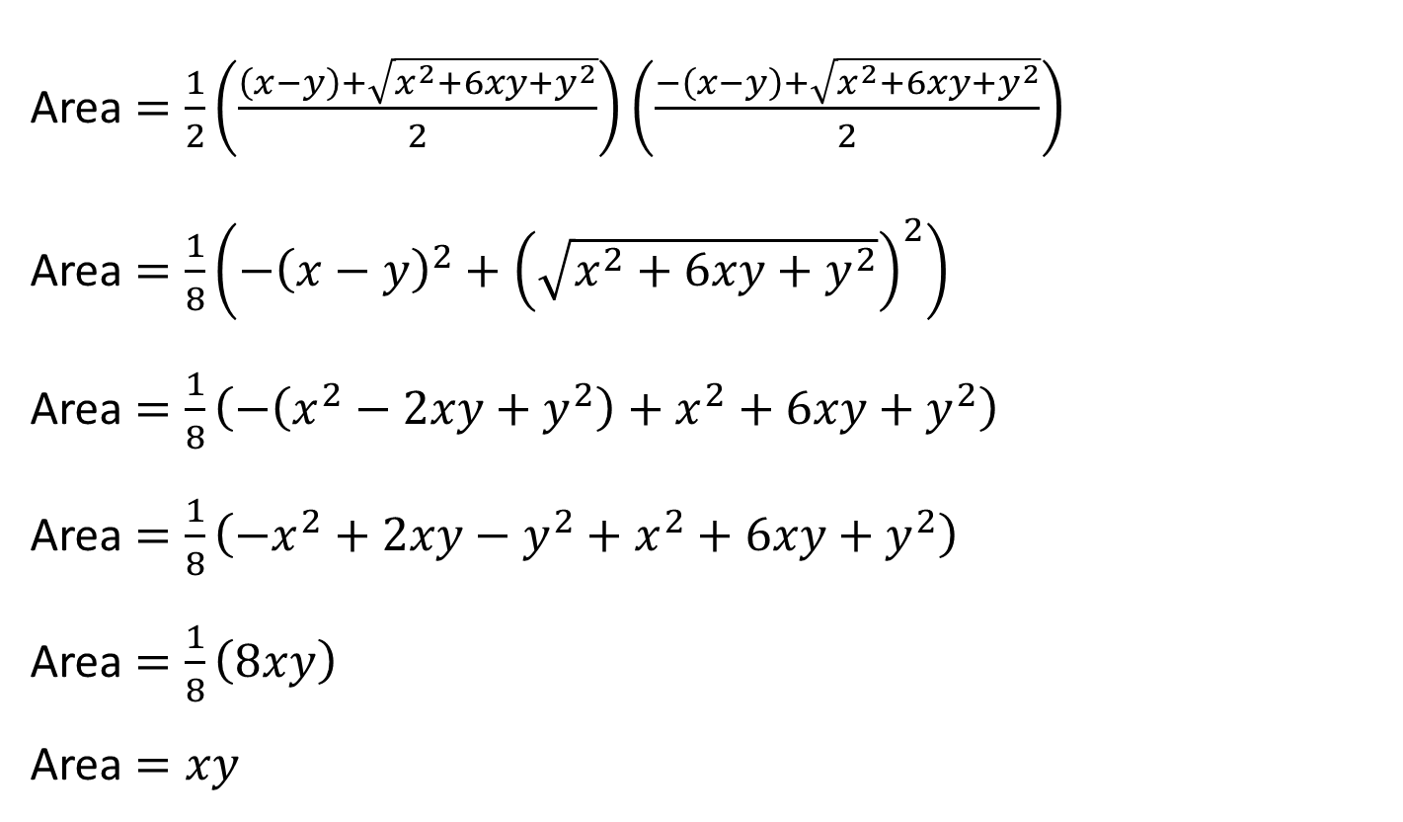
Area $=\frac{1}{2}\left(\frac{\left(x−y\right)+\sqrt{x^{2}+6xy+y^{2}}}{2}\right)\left(\frac{−\left(x−y\right)+\sqrt{x^{2}+6xy+y^{2}}}{2}\right)$
Area $=\frac{1}{8}\left(−{\left(x−y\right)}^{2}+{\left(\sqrt{x^{2}+6xy+y^{2}}\right)}^{2}\right)$
Area $=\frac{1}{8}\left(−\left(x^{2}−2xy+y^{2}\right)+x^{2}+6xy+y^{2}\right)$
Area $=\frac{1}{8}\left(−x^{2}+2xy−y^{2}+x^{2}+6xy+y^{2}\right)$
Area $=\frac{1}{8}\left(8xy\right)$
Area $=xy$

Slide 17
Resources

Slide 18


What’s the area of the triangle?
$$2$$
(not to scale)
$$4$$
(The circle is tangent to the three sides of the triangle.)
SIC_11

Slide 19


What’s the area of the triangle?
$$3$$
(not to scale)
$$5$$
(The circle is tangent to the three sides of the triangle.)
SIC_11

Slide 20


What’s the area of the triangle?
$$6$$
(not to scale)
$$8$$
(The circle is tangent to the three sides of the triangle.)
SIC_11

Slide 21

What’s the area of the triangle?
$$3$$
(not to scale)
$$6$$
(The circle is tangent to the three sides of the triangle.)
SIC_11

Slide 22
What’s the area of the triangle?
$$2$$
(not to scale)
$$5$$
(The circle is tangent to the three sides of the triangle.)
SIC_11

Slide 23

What’s the area of the triangle?
$$3$$
(not to scale)
$$7$$
(The circle is tangent to the three sides of the triangle.)
SIC_11

Slide 24

What’s the area of the triangle?
$$6$$
(not to scale)
$$10$$
(The circle is tangent to the three sides of the triangle.)
SIC_11

Slide 25
What’s the area of the triangle?
$$3$$
(not to scale)
$$8$$
(The circle is tangent to the three sides of the triangle.)
SIC_11

Slide 26

What’s the area of the triangle?
$$2$$
(not to scale)
$$3$$
(The circle is tangent to the three sides of the triangle.)
SIC_11

Slide 27

What’s the area of the triangle?
$$4$$
(not to scale)
$$6$$
(The circle is tangent to the three sides of the triangle.)
SIC_11

Slide 28

What’s the area of the triangle?
$$6$$
(not to scale)
$$9$$
(The circle is tangent to the three sides of the triangle.)
SIC_11

Slide 29


What’s the area of the triangle?
$$8$$
(not to scale)
$$12$$
(The circle is tangent to the three sides of the triangle.)
SIC_11

Slide 30

What’s the area of the triangle?
$$5$$
(not to scale)
$$7$$
(The circle is tangent to the three sides of the triangle.)
SIC_11

Slide 31
What’s the area of the triangle?
$$6$$
(not to scale)
$$7$$
(The circle is tangent to the three sides of the triangle.)
SIC_11

Slide 32
What’s the area of the triangle?
$$2$$
(not to scale)
$$7$$
(The circle is tangent to the three sides of the triangle.)
SIC_11

Slide 33

What’s the area of the triangle?
$$7$$
(not to scale)
$$9$$
(The circle is tangent to the three sides of the triangle.)
SIC_11

